Slide 1
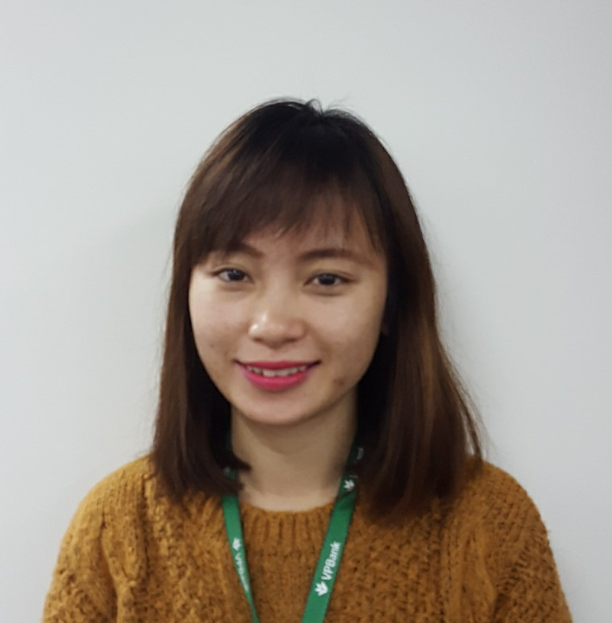
A bright, talented and self-motivated data analyst who has excellent organizational skills, is efficient and has a good eye for detail. Bachelor degree in Finance & Banking at NEU. Over 4 years at Vpbank.

Slide 2

Ha graduated from Warwick University in 2013 with a Msc in Accounting and Finance. She assumed the role of Senior Business Intelligence at Adayroi for more than 2 years. After joining VBank in Sep 2016 as a Business Analyst, she found her passion in Analytics and decided to choose it as the goal for her career path.

Slide 3

Member of Proactive Analytics Team – Retail Department – Business Intelligence Competency Center – VPBank.
Studied Mathematical Economics at Odessa I.I.Mechnikov National University.
Experienced working at Joint Stock Commercial Banks, have a good base of logical thought and business sense.

Slide 4

A proactive and dynamic professional with a strong academic background in banking & finance. Earned a Master degree in Finance at Coventry University, UK. Joined BICC in August, 2016.
Studied at Coventry University. Working at BICC - VPBank since July, 2016. Good sense of BA, BI and building customer relationships

Slide 5
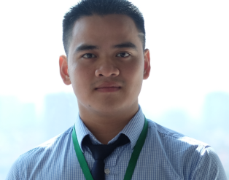
Họ và tên: Đặng Tuấn Vũ.
Tốt nghiệp: Toán Kinh Tế - Kinh Tế Quốc Dân
Chứng chỉ: “Dự báo trong Kinh tế vĩ mô sử dụng mô hình chuỗi thời gian.”
Kinh nghiệm làm việc: 07/2015 – nay: Chuyên viên Phân tích Khách hàng doanh nghiệp – Trung tâm Phân tích kinh doanh – VPBank.
Kĩ năng: Sử dụng thành thạo SQL, R, excel.
Graduated from the National Economics University majoring in Math. Business Analyst in SME Department of BICC – VPBank.

Slide 6
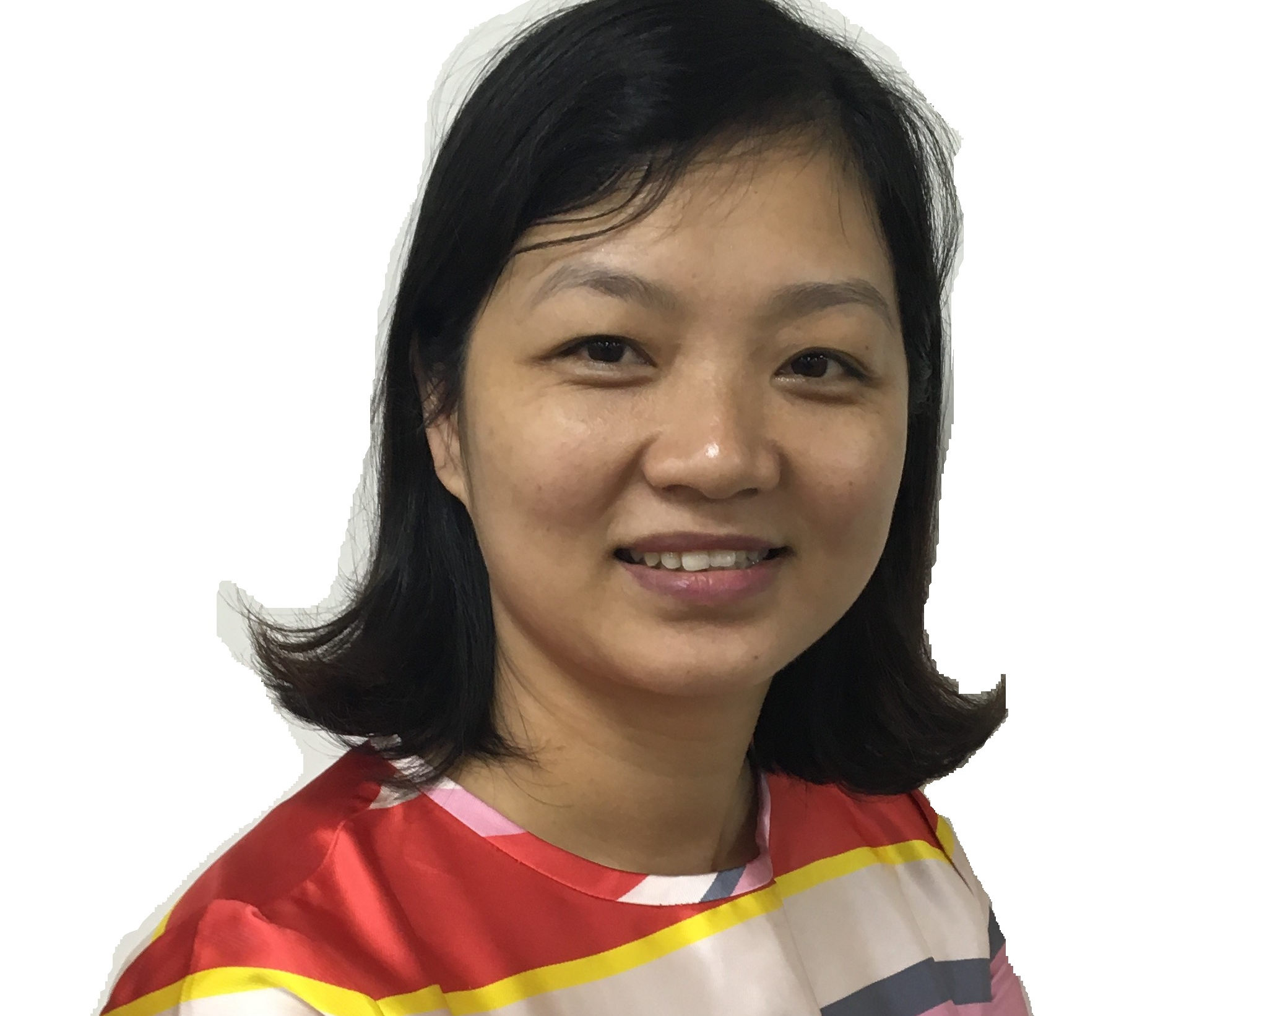
Vietnam University of Commerce, 10+ years in banking sector, Great bank product sense and extremely efficient in deep analyzing in finance and business

Slide 7
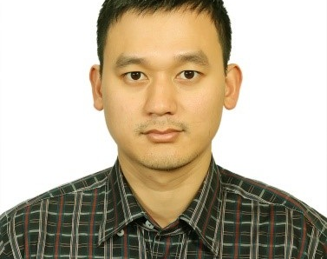
Working in construction field for 4 years as civil engineer. Starting working at VPBank from Feb-2016 in Corporate Department and joining Analytic Team since Dec/2016 in Business Intelligence Competency Center.
Master degree: Coventry University, UK, Major: MSc Finance.
Bachelor: National University of Civil Engineering, Major: Civil Engineer.

Slide 8
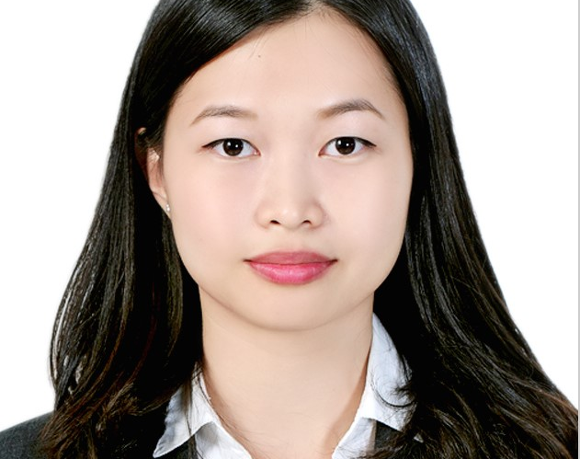
Shanghai University of Finance and Economics BA, University of North Carolina Charlotte MBA in Business Analytics. Professional experience in China, US and Vietnam in analyzing data in various domains of banking, education, NGOs, retail and automotive technology. Senior Data Analyst at VPBank Oct.,2016

